Slide 1
AND GATE
X | Y | X.Y
0 | 0 | 0
0 | 1 | 0
1 | 0 | 0
1 | 1 | 1

Slide 2
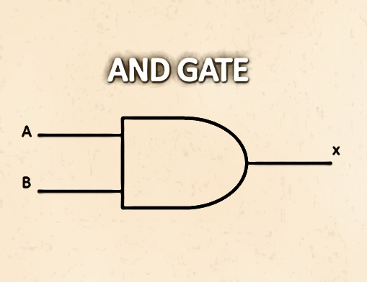
102
0
0

Slide 3
102
0
1

Slide 4
1
0
0

Slide 5
1
1
1

